Slide 1
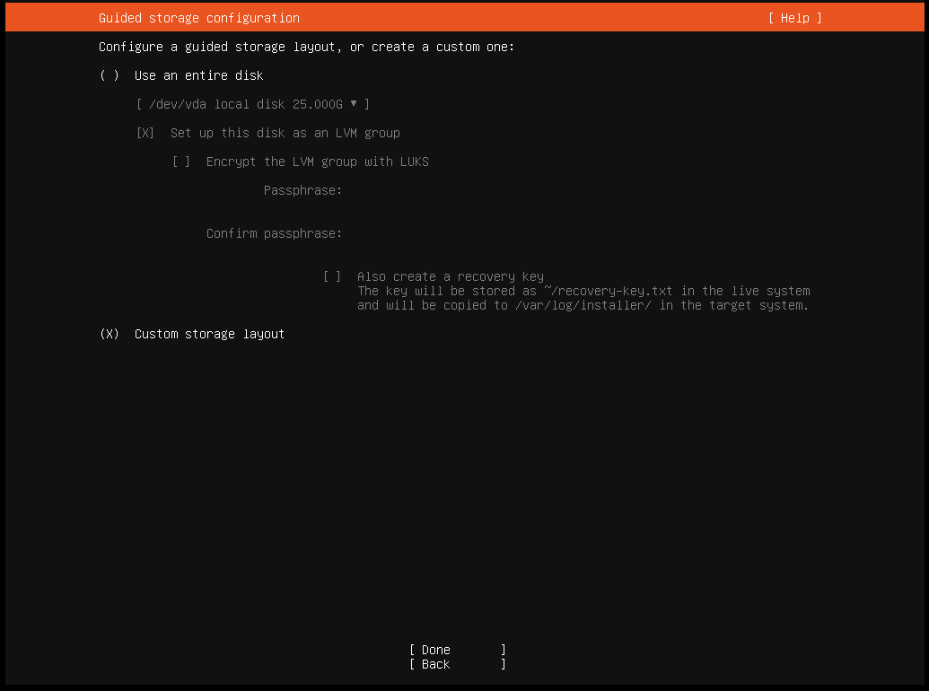
SOFTWARE RAID

Slide 2
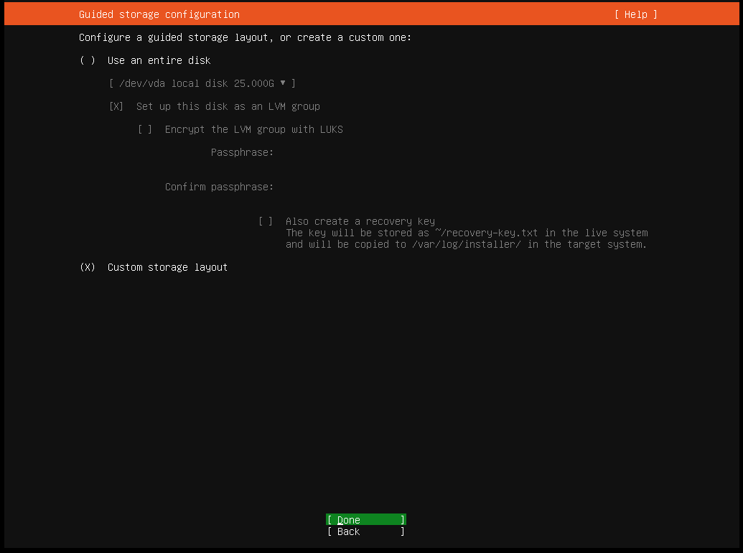
In above image we have to select custom storage layout and --> done --> Enter

Slide 3
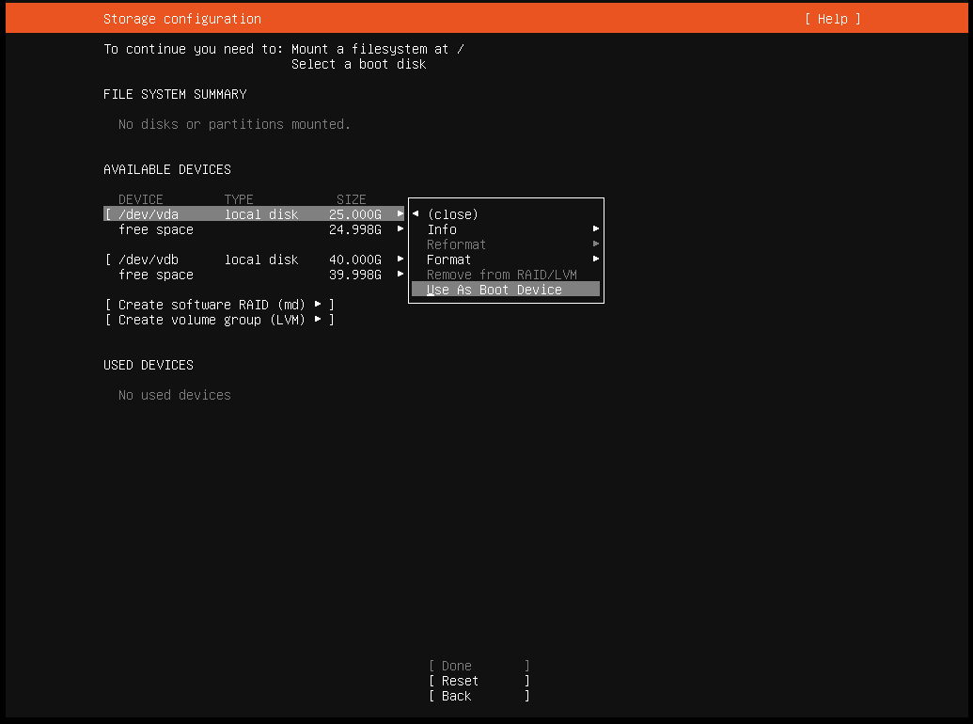
On first disk /dev/vda --> press enter on this line -->in drop down select , Use as a boot device -> enter
Same as second disk /dev/vdb --> press enter on this line --> in drop down select , add another boot as device -->enter

Slide 4
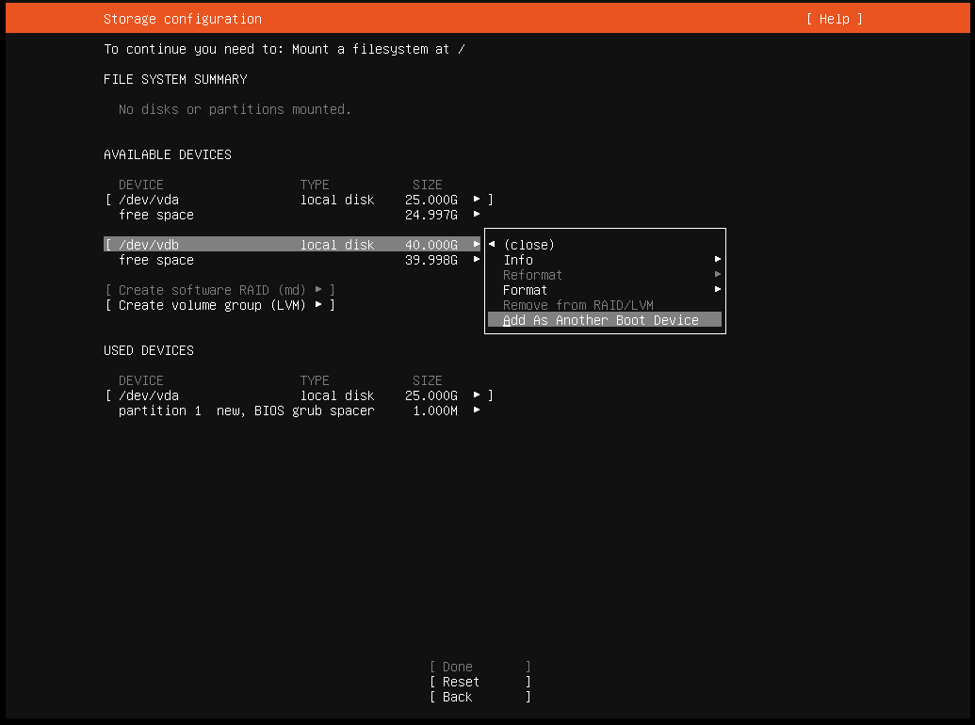
This is on second disk.

Slide 5
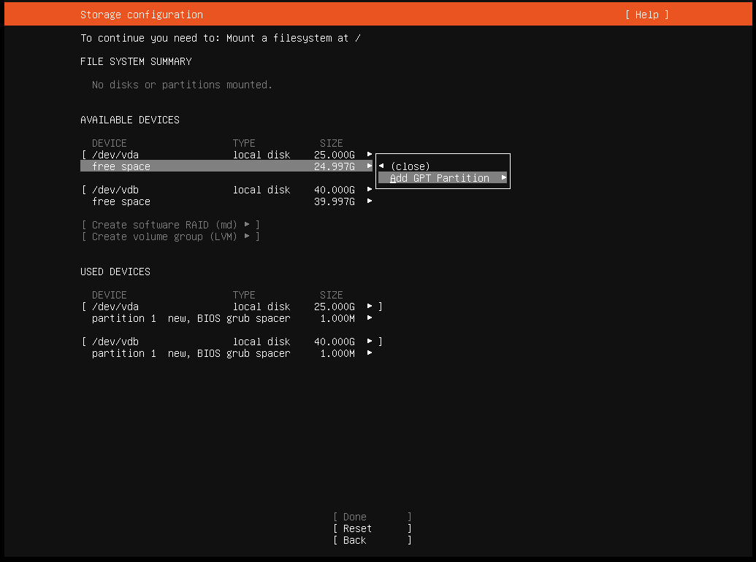
Now enter free space of disk /dev/vda --> in drop down --> Add GPT partition -->enter .

Slide 6
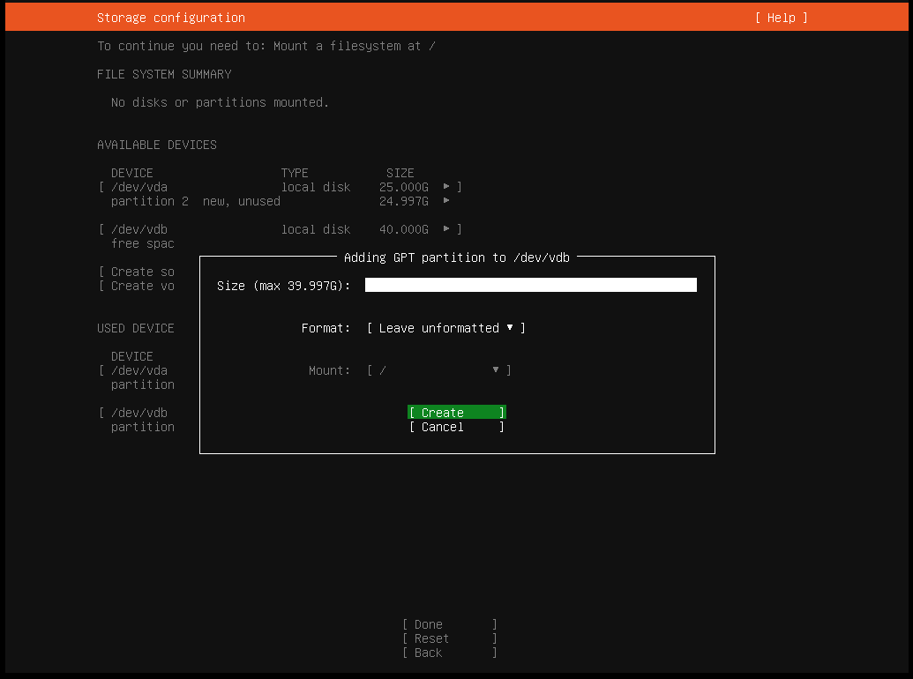
Like this in GPT partition take full size -> format = Leave unformatted --> create and do same as on second disk.

Slide 7
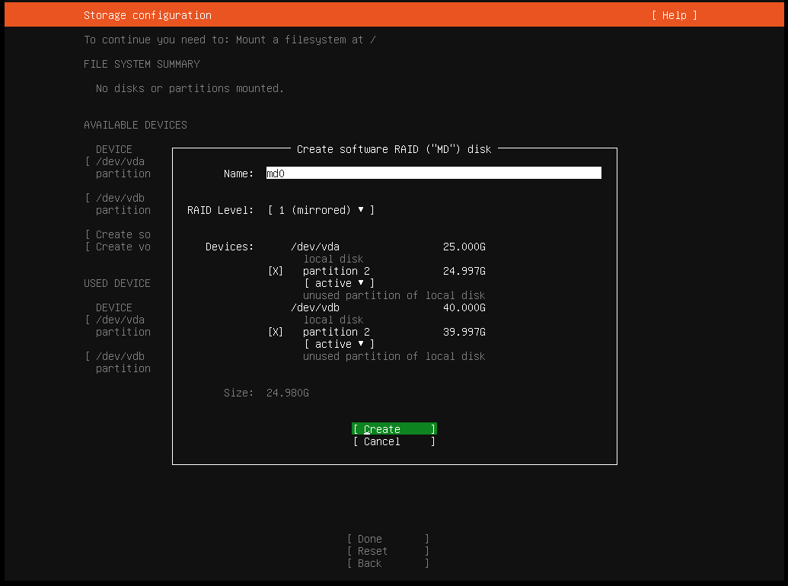
Now select option – Create software Raid(md) --> enter –> in this section you can see like this.here give the name of raid – select raid level – and select partition just you have created in above steps(GPT PARTITION) , like here partition2 on /dev/vda and partition2 on /dev/vdb.

Slide 8
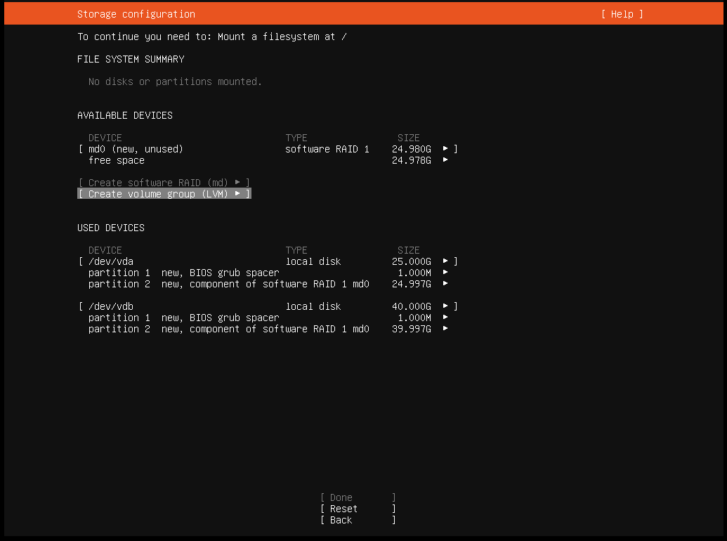
Now in earlier steps you have created RAID so in next step , we will create volume group --> so click on Create volume group(LVM).

Slide 9
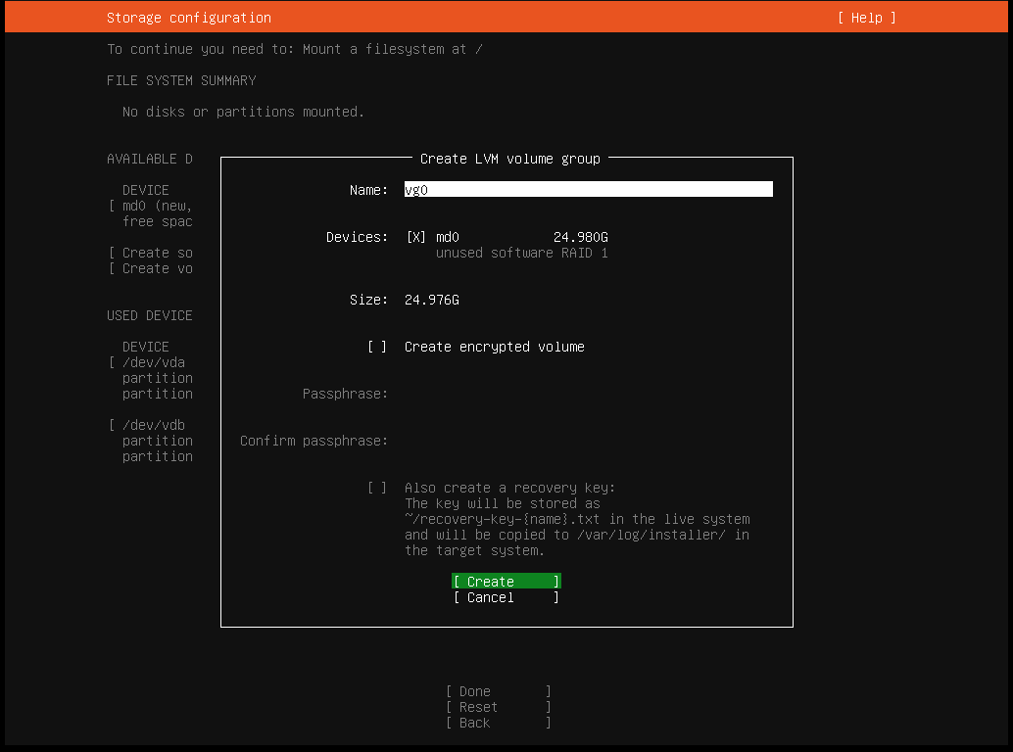
When you enter at create volume group(LVM)--then slide will open. Here you give volume group name(any) and select Raid you have just created in above steps , like md0 --> select this and create.

Slide 10
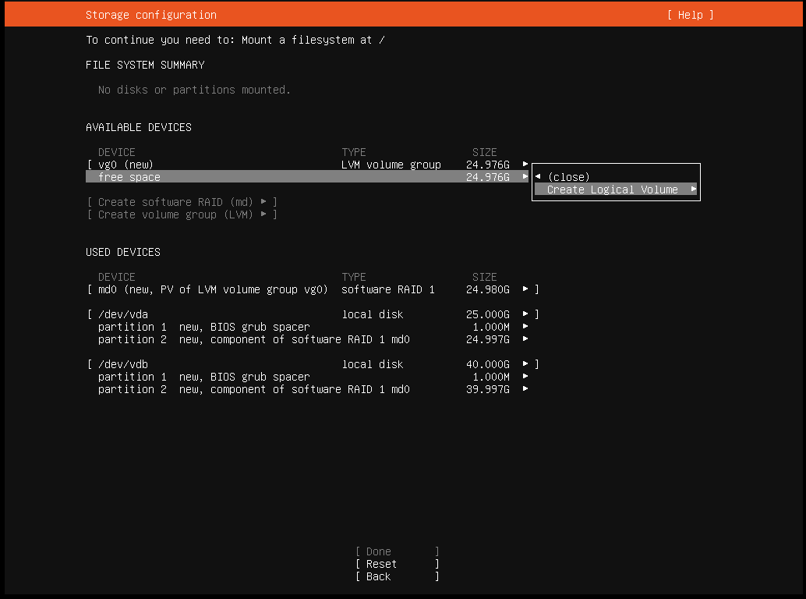
Now click on the free space of Volume group that you just have created, and click on --> create logical volume -> enter.

Slide 11
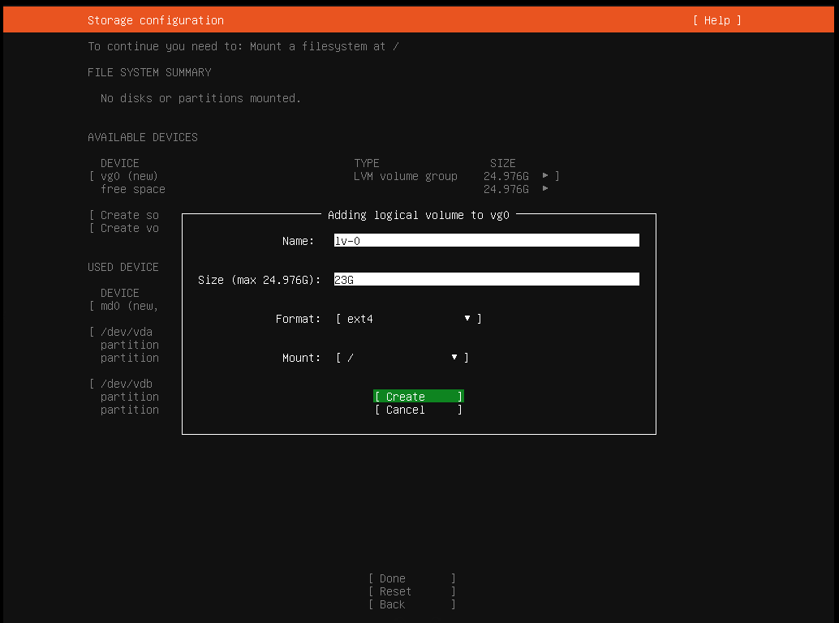
Now here give the logical volume name,eg=lv0 --> Give size of LV, eg= 23G --> format = ext4 --> mount = /(root) --> this is main partition for os installation. --> and create
In same manner create different logical volume like name= lv1 --> size = 2G --> format = ext4 --> mount = /boot(select from drop down) --> and create.

Slide 12
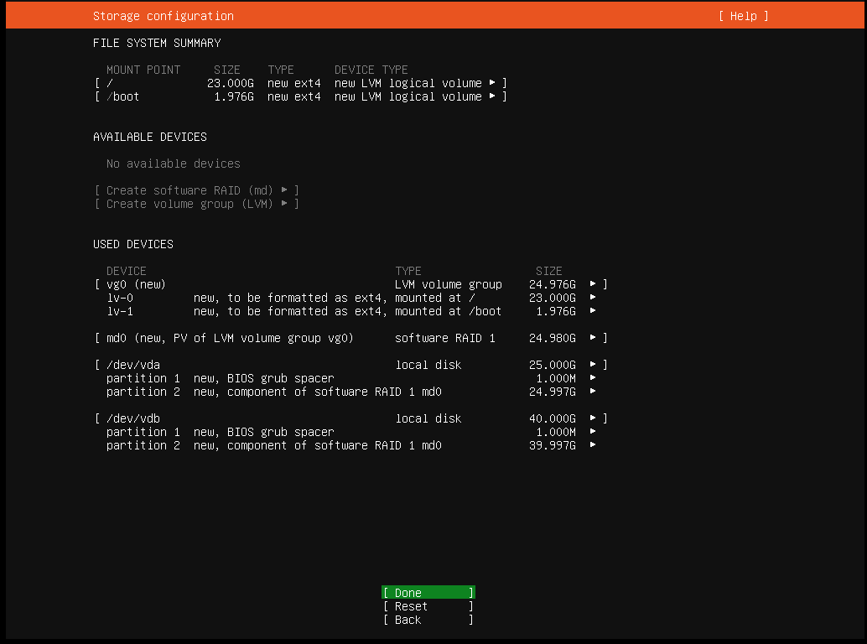
And finally your raid created now you press enter on Done.

